Slide 1

Transfer Learning
Dr. David Raj M
Assistant Professor & Assistant Director, RAAC
School of Advanced Sciences
Vellore Institute of Technology, Chennai

Slide 2
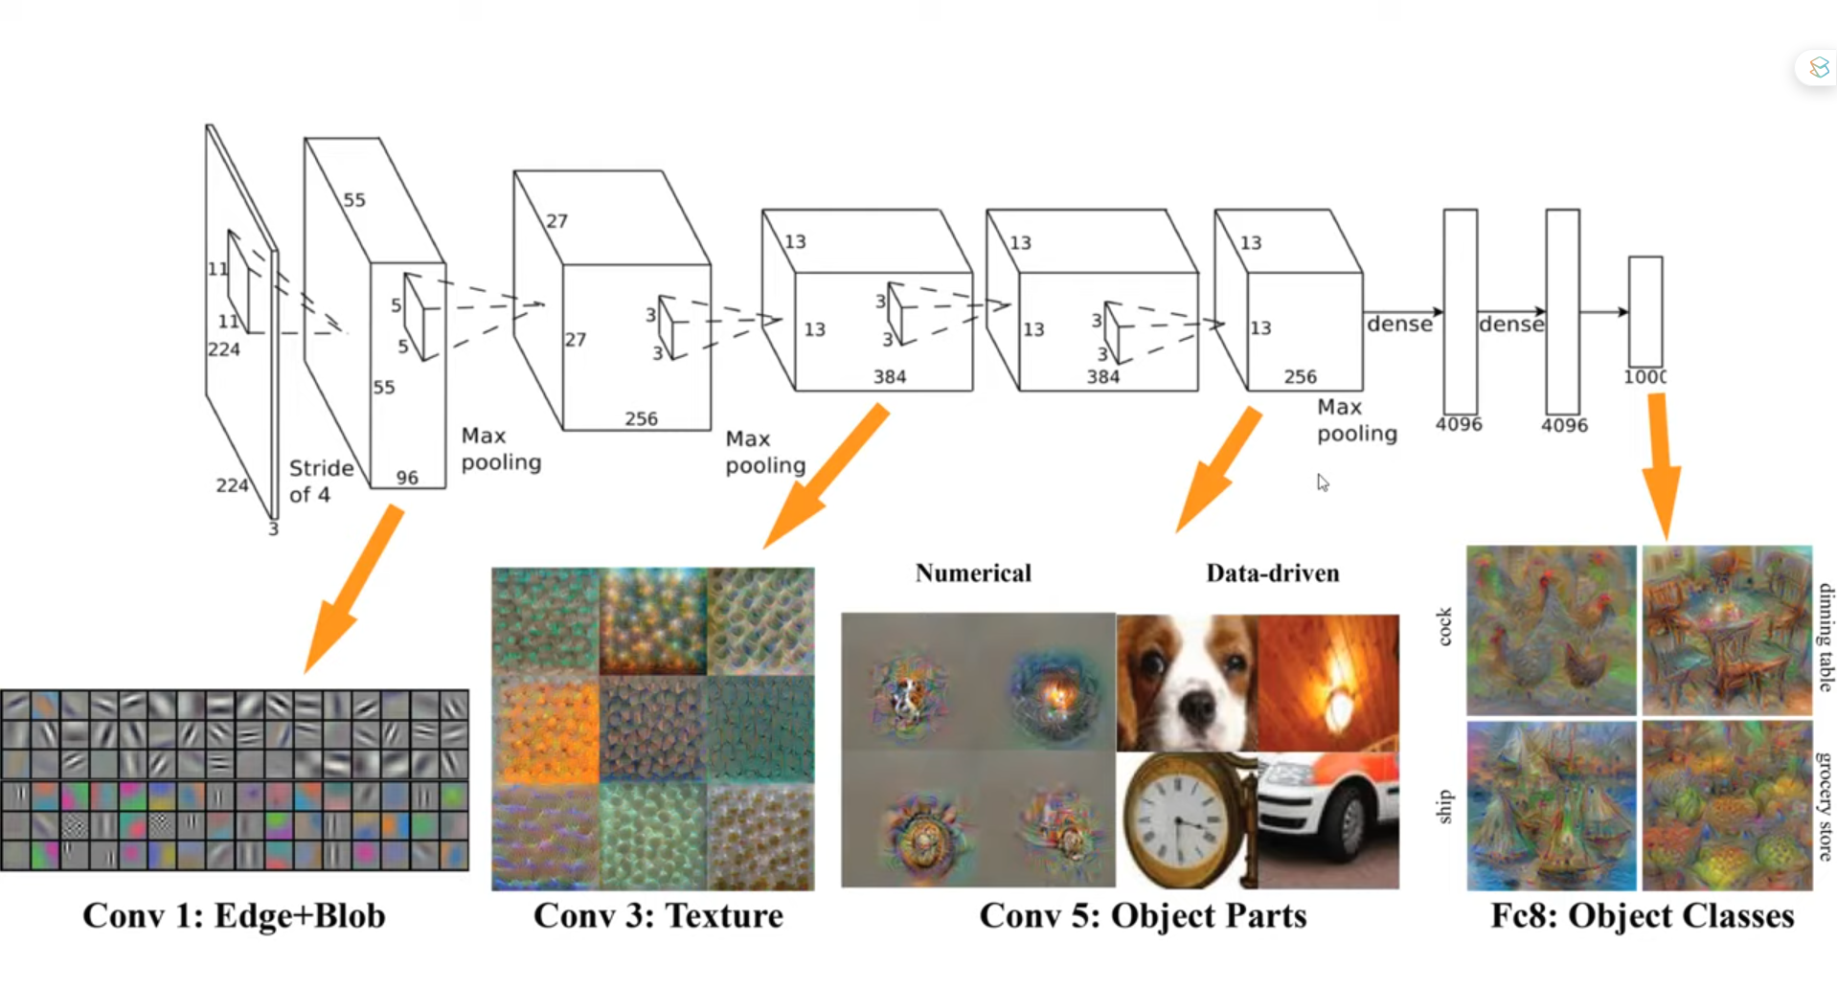

Slide 3
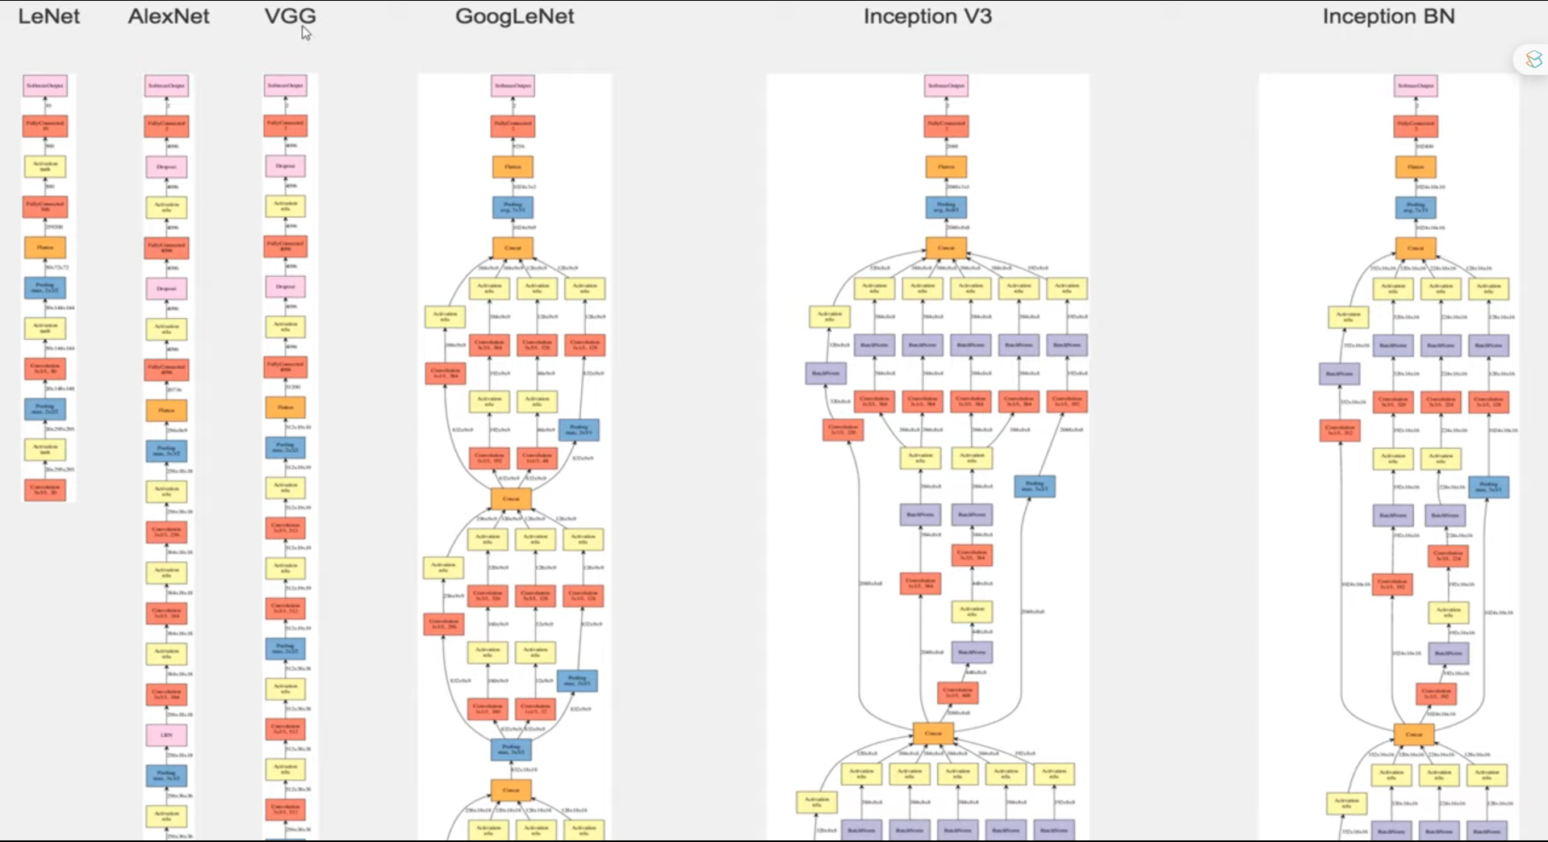

Slide 4
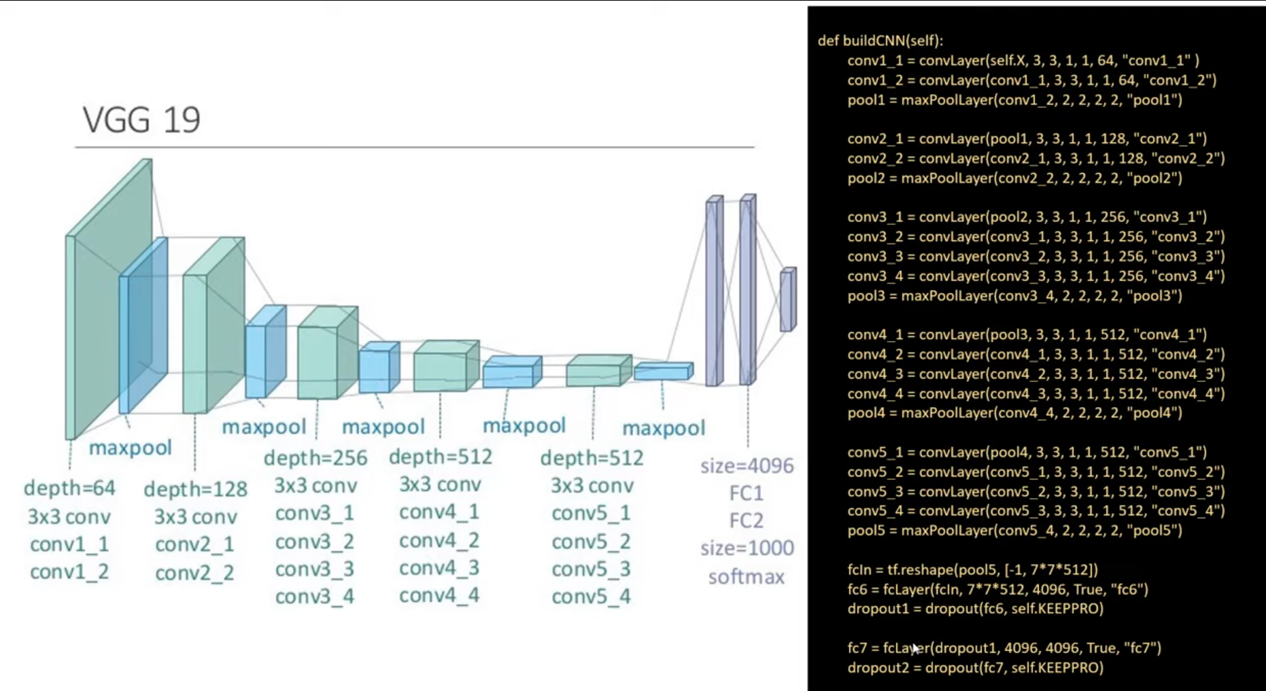

Slide 5
U – Net Architecture is designed for Semantic Segmentation

Slide 6
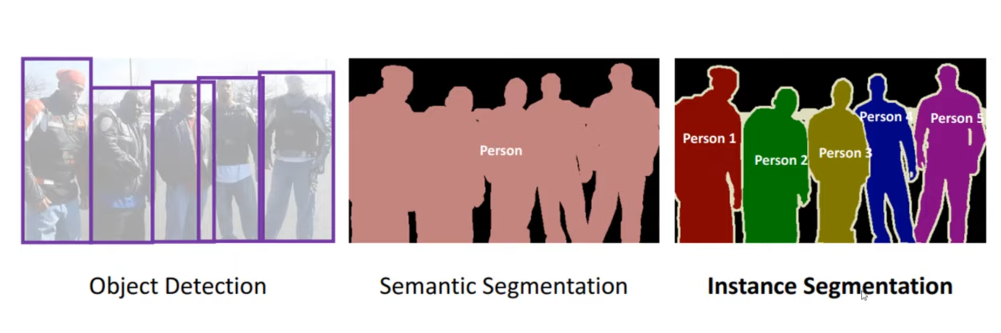

Slide 7
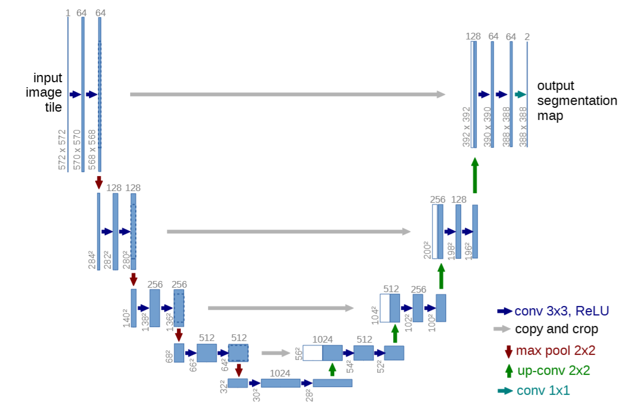
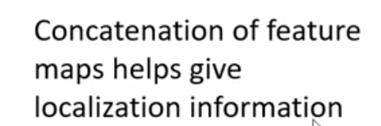

Slide 8
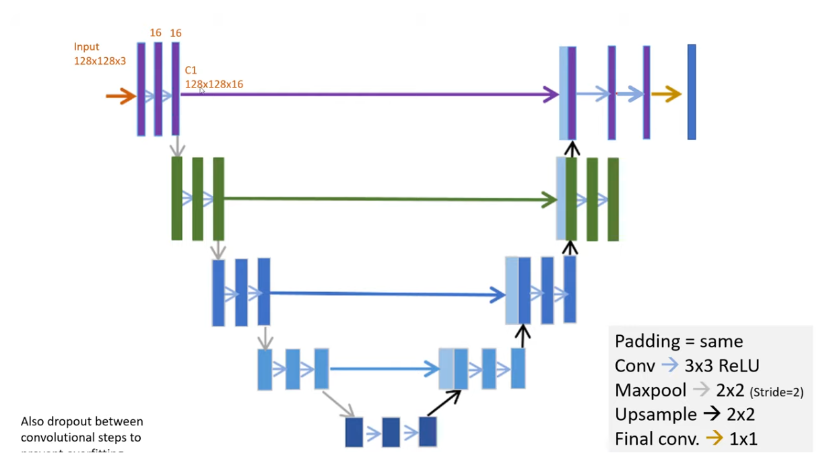

Slide 9
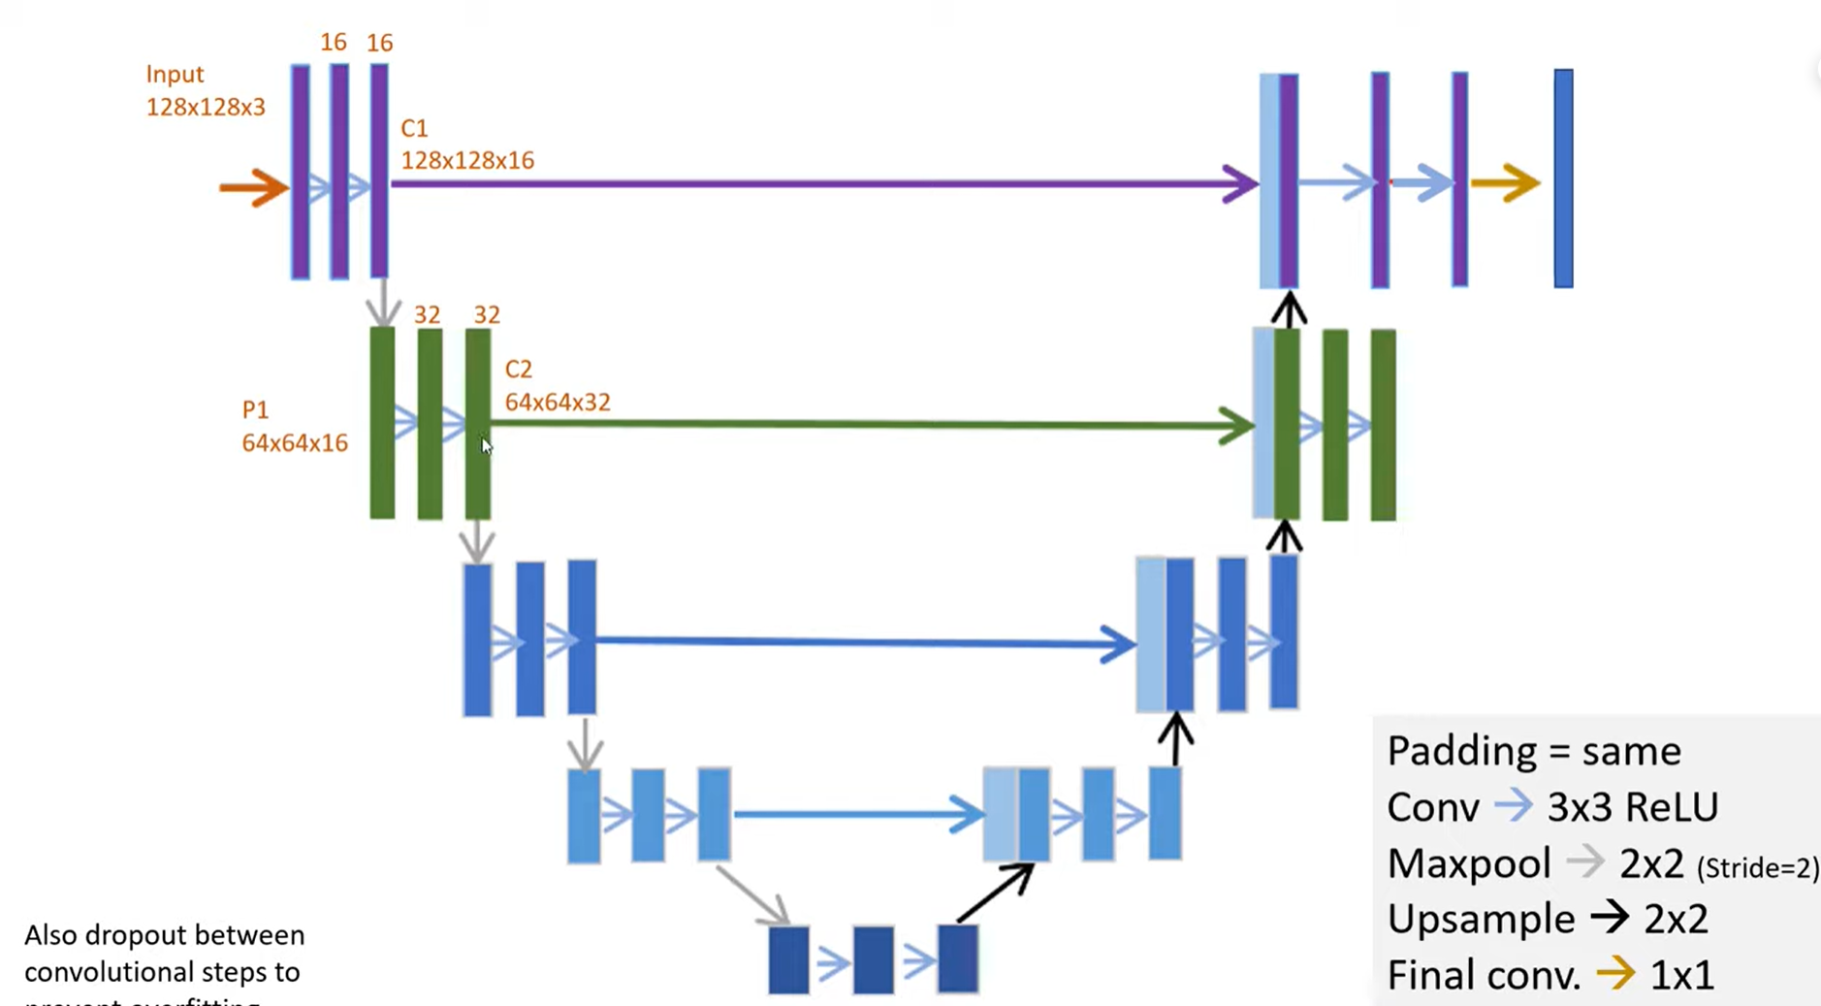

Slide 10
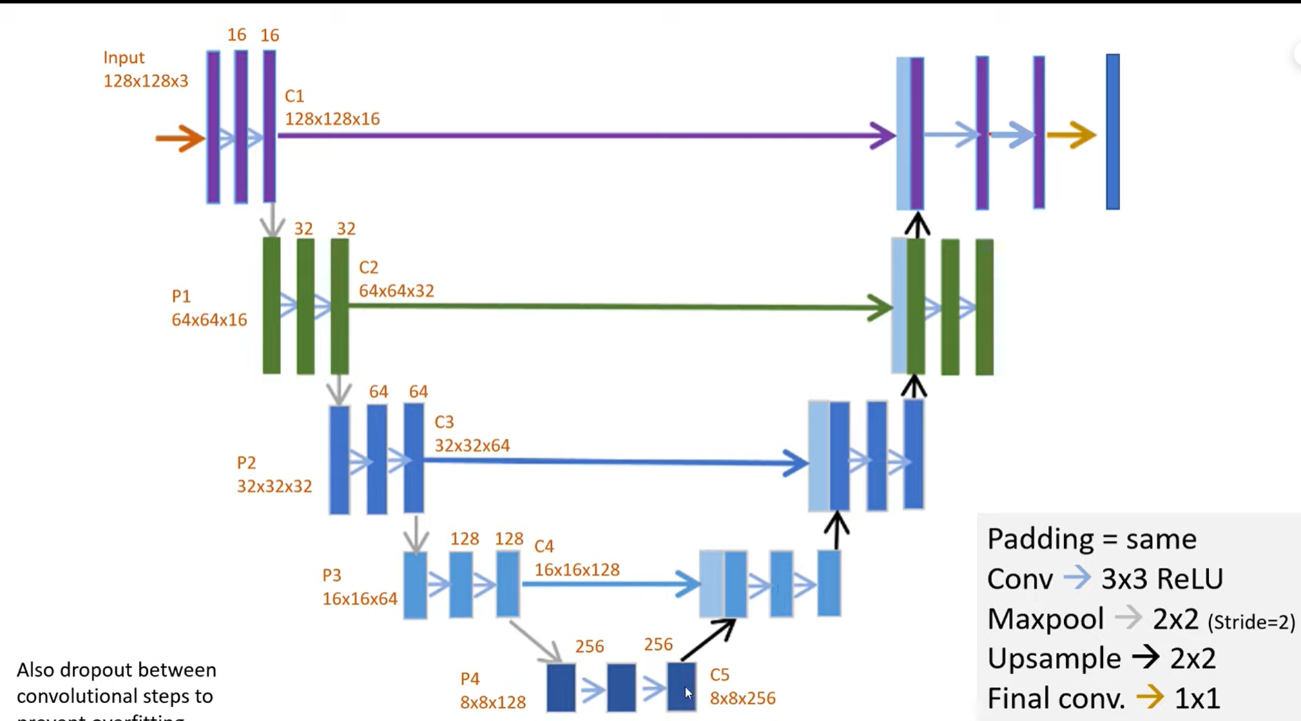

Slide 11
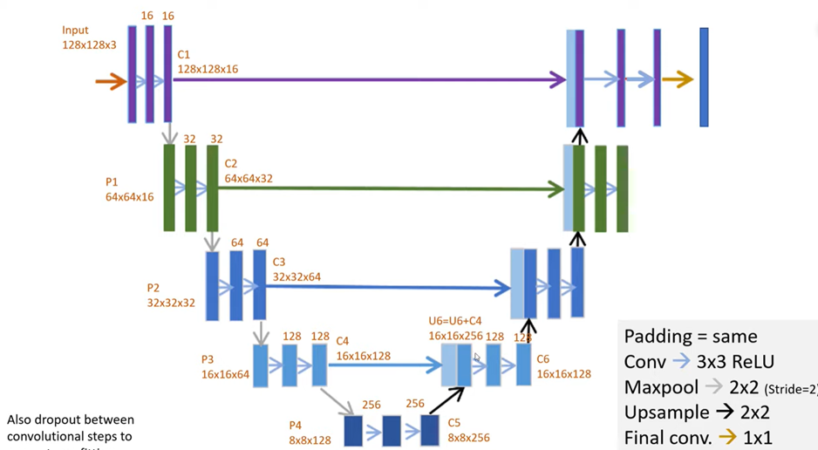

Slide 12
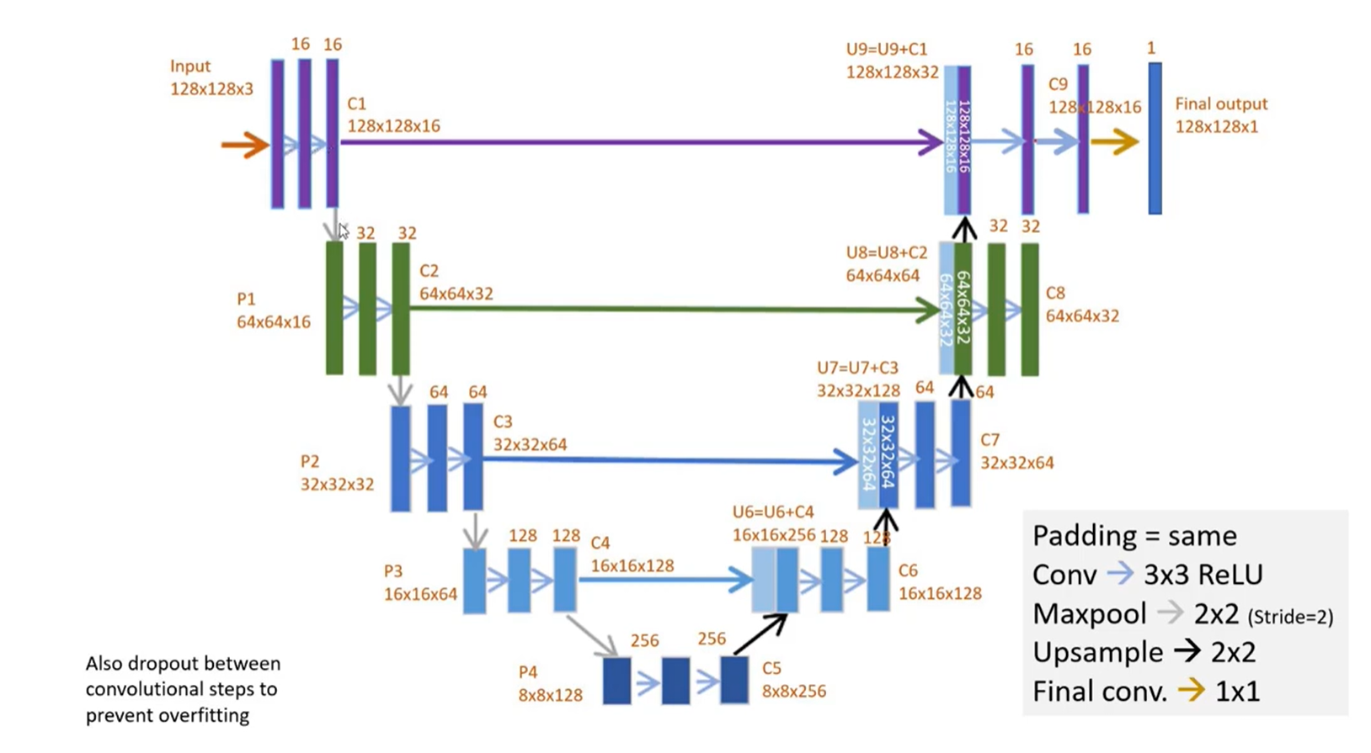

Slide 13
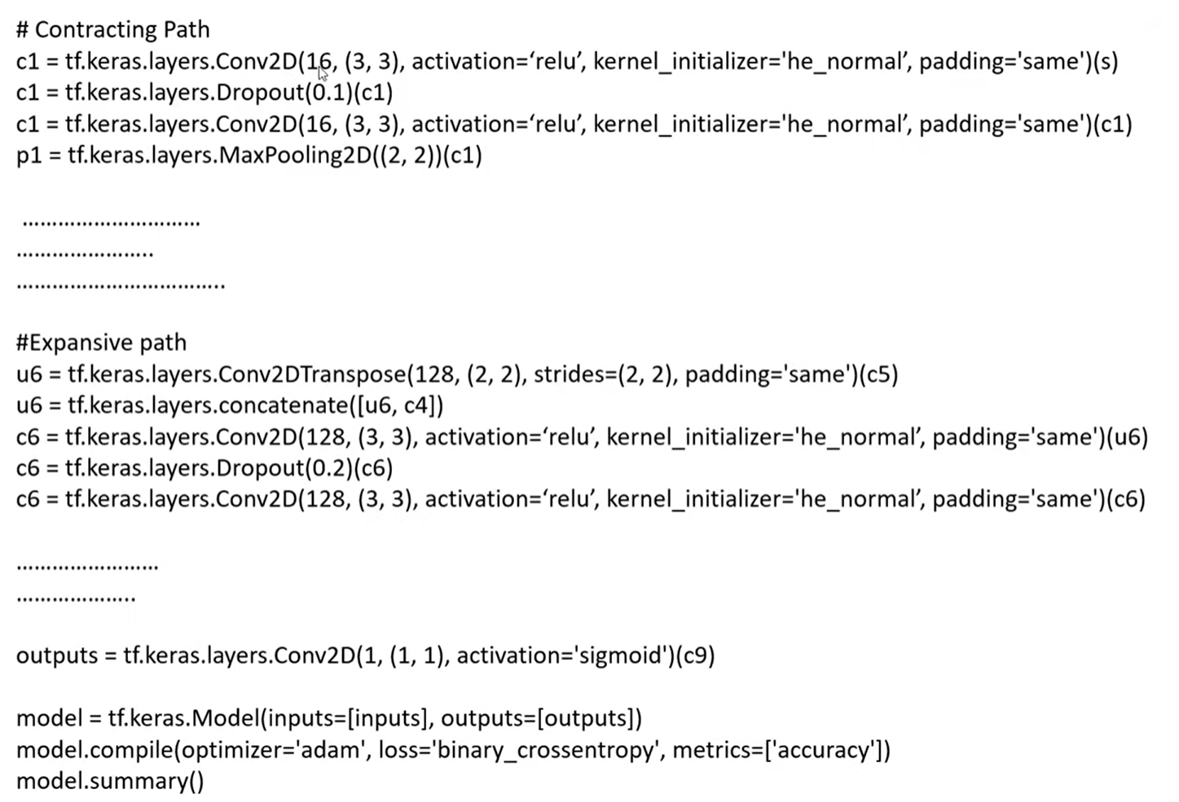

Slide 14
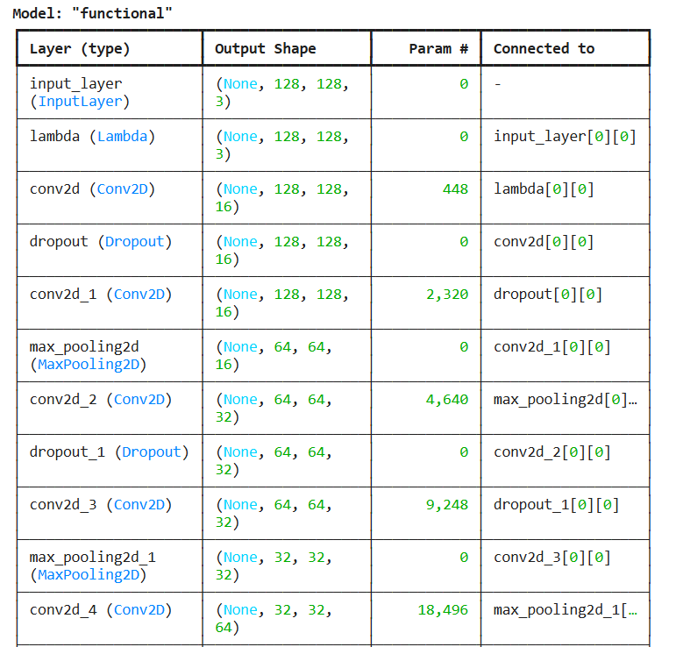

Slide 15
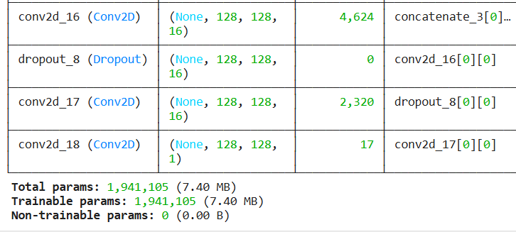

Slide 16
TRAINABLE PARAMETERS

Slide 17
Model fitting, checkpoints, and callbacks
https://www.tensorflow.org/api_docs/python/tf/keras/callbacks

Slide 18
Understanding the data
https://bbbc.broadinstitute.org/BBBC038
https://www.kaggle.com/c/data-science-bowl-2018/data
https://youtu.be/eHwkfhmJexs

